Slide 1
SQL Joins
Sakina Neemuchwala

Slide 2
Introduction to SQL
SQL (Structured Query Language) is used to store, retrieve, and manage data in relational databases.
Relational databases organize data in tables with rows and columns.
SQL allows you to insert, update, delete, search, and optimize data.
It became an ANSI standard in 1986 and ISO standard in 1987.

Slide 3
Have You Ever Combined Two Excel Sheets?
Sheet1: Customers with ID and Name
Sheet2: Orders with ID and Product
Final result using VLOOKUP to pull product names
Excel Formula:
=VLOOKUP(A2, Orders!A2:C100, 2, FALSE)
Notes:
Imagine you have one Excel file with customer details and another with order data. Your manager says: "Give me a list of customers and what they ordered."
What would you do in Excel? You’d likely use VLOOKUP.
This formula finds the Customer ID (A2) in the Orders sheet (A2:C100) and returns the matching Product name from the 2nd column. FALSE ensures an exact match.

Slide 4
Excel VLOOKUP = SQL JOIN?
SQL Joins are just a more powerful way of doing what you already do in Excel: pulling data together from different tables.
But SQL gives you more control over what kind of matches you want and scalable than Excel.
It handles large data sets efficiently, allows precise joins and filtering, and reduces manual errors compared to formulas like VLOOKUP.
Excel Term | SQL Equivalent
Worksheet | Table
Row | Record
Column | Field
VLOOKUP | JOIN
#N/A (No Match) | NULL

Slide 5
Case-Study to understand Joins
Mark runs a online Computer store in Germany.
Mark’s business has a database that stores all the customers in the Customer table and all orders in the Orders table.
For his business to grow, he needs to do analysis by answering some of the following questions:
Who ordered what?
Who hasn’t ordered yet?
Which orders came from unknown customers?

Slide 6
What are Joins?
The Challenge:
Customers shows who, but not what they bought
Orders shows what, but only links to a CustomerID
You need both tables to get the full picture.
To answer your business questions, you need to connect these tables using JOINS.
What Are JOINS?
JOINS let you combine data from multiple tables using a common key.
In this case: Orders.CustomerID = Customers.ID
They help you bring the full picture together for better analysis.

Slide 7
Types of Joins
Joins
Inner Join
Outer Join
Left Outer Join OR Left Join
Full Outer Join
Right Outer Join OR Right Join

Slide 8
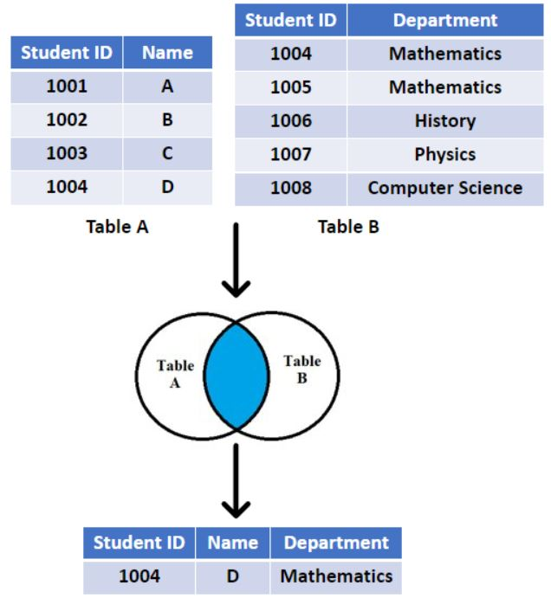
INNER JOIN
INNER JOIN: Returns only the rows where there is a match in both tables.

Slide 9
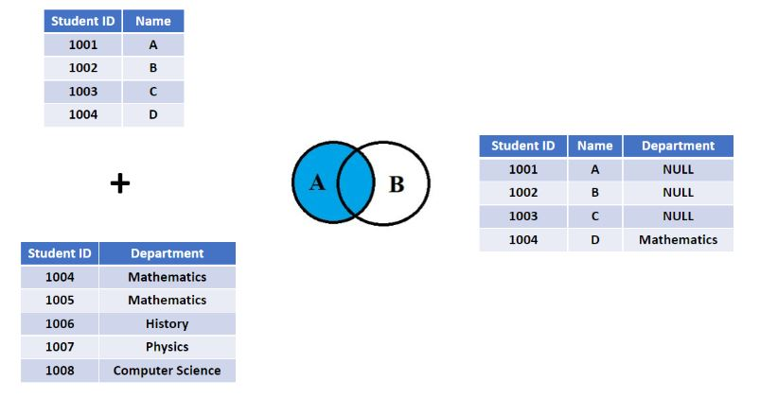
LEFT OUTER JOIN or LEFT JOIN
LEFT JOIN: Returns all rows from the left table, and the matched rows from the right table.
If there's no match, NULL values are returned for columns from the right table.

Slide 10
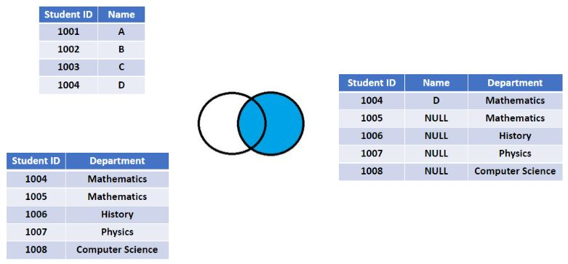
RIGHT OUTER JOIN or RIGHT JOIN
RIGHT JOIN: Returns all rows from the right table, and the matched rows from the left table.
If there's no match, NULL values are returned for columns from the left table.

Slide 11
Data Tables – Online Stores in Germany
Customers Table
customer_id | name | city
1 | Alice | Berlin
2 | Bob | Munich
3 | Carol | Hamburg
4 | David | Frankfurt
Orders Table
order_id | customer_id | product | quantity
101 | 1 | Laptop | 1
102 | 1 | Mouse | 2
103 | 2 | Keyboard | 1
104 | 5 | Monitor | 1 | (Invalid customer ID)

Slide 12
INNER JOIN -Example
SELECT c.name, c.city, o.product, o.quantity
FROM Customers c
INNER JOIN Orders o
ON c.customer_id = o.customer_id;
Result:
name | city | product | quantity
Alice | Berlin | Laptop | 1
Alice | Berlin | Mouse | 2
Bob | Munich | Keyboard | 1
Notes:
Note:
It performs a JOIN between two tables — Customers and Orders — to combine data where the customer_id is the same in both tables.
You can see who ordered what, from where, and how many.

Slide 13
LEFT JOIN - Example
SELECT c.name, c.city, o.product, o.quantity
FROM Customers c
LEFT JOIN Orders o
ON c.customer_id = o.customer_id;
Result:
name | city | product | quantity
Alice | Berlin | Laptop | 1
Alice | Berlin | Mouse | 2
Bob | Munich | Keyboard | 1
Carol | Hamburg | NULL | NULL
David | Frankfurt | NULL | NULL
Notes:
Note:
The goal is to show all customers, along with any matching orders they might have — even if they haven’t placed any orders.
Shows Carol and David even though they haven’t ordered -- that’s what makes LEFT JOIN special.

Slide 14
RIGHT JOIN - Example
SELECT c.name, c.city, o.product, o.quantity
FROM Customers c
RIGHT JOIN Orders o
ON c.customer_id = o.customer_id;
Result:
name | city | product | quantity
Alice | Berlin | Laptop | 1
Alice | Berlin | Mouse | 2
Bob | Munich | Keyboard | 1
NULL | NULL | Monitor | 1
Notes:
Note:
The goal is to show all orders, along with the name and city of the person who placed them, if that person is listed in the Customers table (based on matching name and city).
Shows the Monitor order even though the name and city are NULL in the Orders table and don't match anyone in Customers -- that's what makes RIGHT JOIN special. It ensures all records from the Orders table are included.

Slide 15
FULL OUTER JOIN
Returns all rows from both tables. Where there is no match, it returns NULL for the columns of the table that doesn't have a match.
SELECT c.name, c.city, o.product, o.quantity
FROM Customers c
FULL OUTER JOIN Orders o
ON c.customer_id = o.customer_id;
Result:
name | city | product | quantity
Alice | Berlin | Laptop | 1
Alice | Berlin | Mouse | 2
Bob | Munich | Keyboard | 1
Carol | Hamburg | NULL | NULL
David | Frankfurt | NULL | NULL
NULL | NULL | Monitor | 1
Notes:
Note:
The first three rows show the matched orders for Alice in Berlin and Bob in Munich, combining information from both tables.
Carol from Hamburg and David from Frankfurt appear even though they have no matching entries in the Orders table based on name and city. Their product and quantity are NULL.
The Monitor order (with NULL name and city in the Orders table) is included. Since there's no matching name and city in the Customers table, the c.name and c.city are NULL.
In short, a FULL OUTER JOIN shows you everything from both tables. Where there's a link (based on name and city), you see the combined data. Where there isn't a link in one of the tables, you still see the data from that table, but the columns from the other table will be NULL.

Slide 16
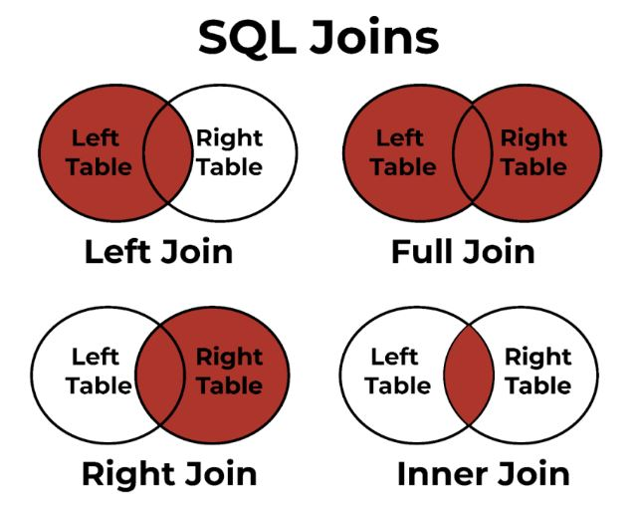
RECAP

Slide 17
Database Tables se Scenario: Berlin Bookstore
PRACTICE EXERCISE
Berlin Books is an independent bookstore with a growing customer base and an online ordering system.
It maintains two main databases:
Customers – stores registered user details
Orders – tracks customer purchases, including book titles and quantities
As a data analyst intern, your task is to extract insights using SQL JOINs.
1. Customers
Stores information about registered customers.
Column Description
ID Unique customer ID
Name Customer's full name
City City where the customer lives
2. Orders
Records purchases made by customers.
Column Description
ID Unique order ID
CustomerID ID of the customer who ordered
Book Title of the book ordered
Quantity Number of copies ordered

Slide 18

EXERCISE QUESTIONS
1. INNER JOIN
List the names and cities of customers who have placed at least one order.
Show each customer's name along with the book title and quantity they ordered.
2. LEFT JOIN
List all customers and their orders (if any). Include customers with no orders.
Identify customers who have not placed any orders.
Show the total number of books ordered by each customer. Include those with zero orders.
3. RIGHT JOIN
Retrieve all order records, along with customer names (if available).
Find orders that do not have a matching customer (e.g., orphaned orders).
4. OUTER JOIN
List all customers and all orders, matching them where possible.
Identify all unmatched records—customers without orders and orders without customers.
Display the name of each customer and the book they ordered (if any). If data is missing on either side, still show the record.

Slide 19
WRAP-UP DISCUSSION
What happens if there is no match in one of the tables?
Which JOIN would you use to include everyone?
How do SQL JOINs compare to Excel's VLOOKUP?
Why is it important to spot unmatched records?

Slide 20

THANK YOU!
Questions?

